Slide 1
OBJECT ORIENTED PROGRAMMING PROJECT GARBA 1.0 India’s next Navratri hub! TEAM
ROLL NO NAME PROGRAMME
AU1841033 YASHVI GANDHI BTECH-ICT
AU1841092 YASHVI PIPALIYA BTECH-ICT

Slide 2
PROBLEM DEFINITION
Usually we don’t get all the things related to Navratri at one place. GARBA 1.0 will solve this issue by providing all the things related to Garba , Navratri at one place.
People will not have to find different things at different places.
Anything related to Navratri is available over here whether it be outfits, songs etc.

Slide 3
OBJECTIVE AND END-USERS
OBJECTIVE : ALL ONE NEEDS TO KNOW AND GET FOR NAVRATRI FESTIVAL. User may not need to go manually at different locations for navratri preparation so time as well as quality information would be obtained.
END-USERS : Anyone interested in navratri, Admin

Slide 4
KEY FUNCTIONALITIES/ FEATURES :
THE MAIN FUNCTIONALITIES ARE:
User can visit the shops where Navratri clothes, jewellery are available.
User can hear to Garba songs.
User can learn Garba watching Garba tutorials.
User can see the list of venues where Navratri is celebrated.
User can book passes of those venues.
User feedback is also available.

Slide 5
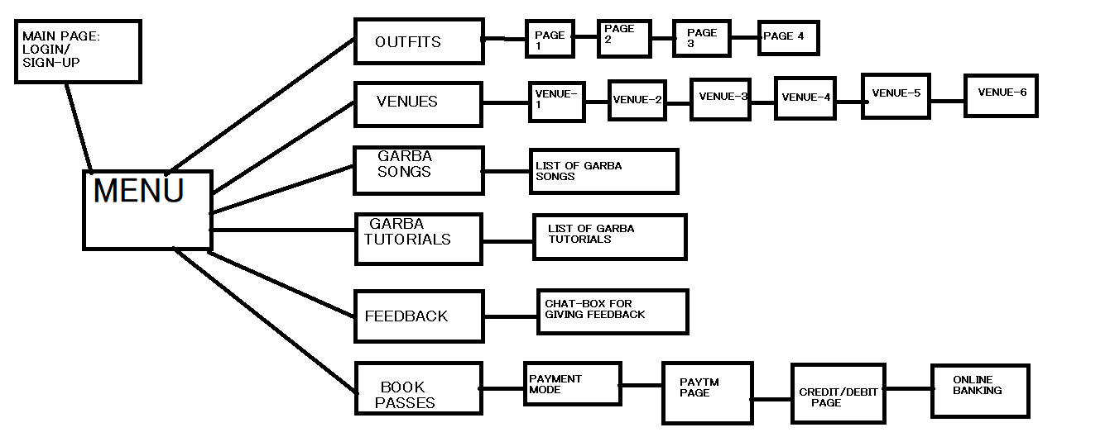
SYSTEM FLOW

Slide 6
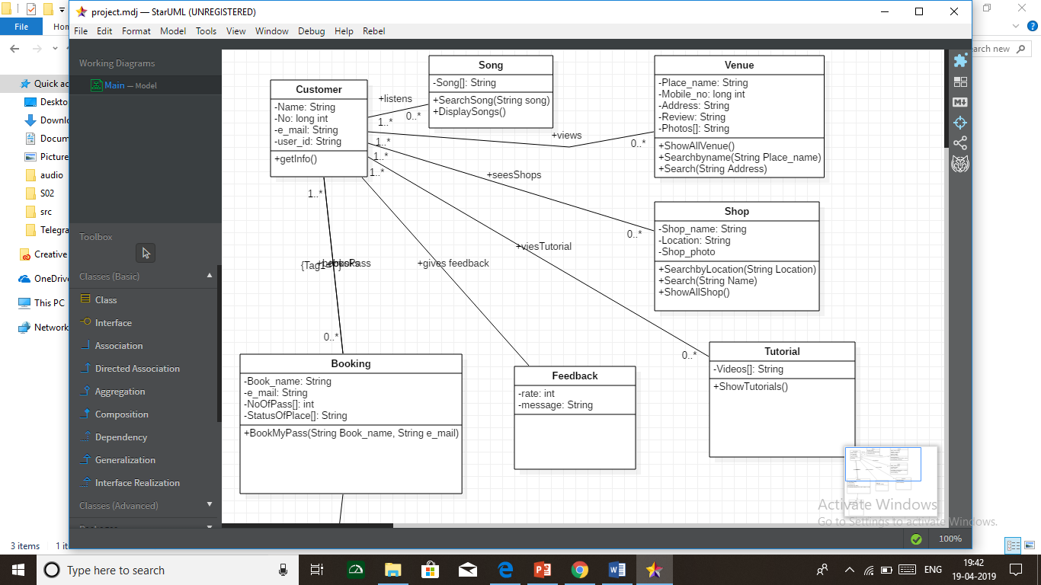
CLASS DIAGRAM

Slide 7
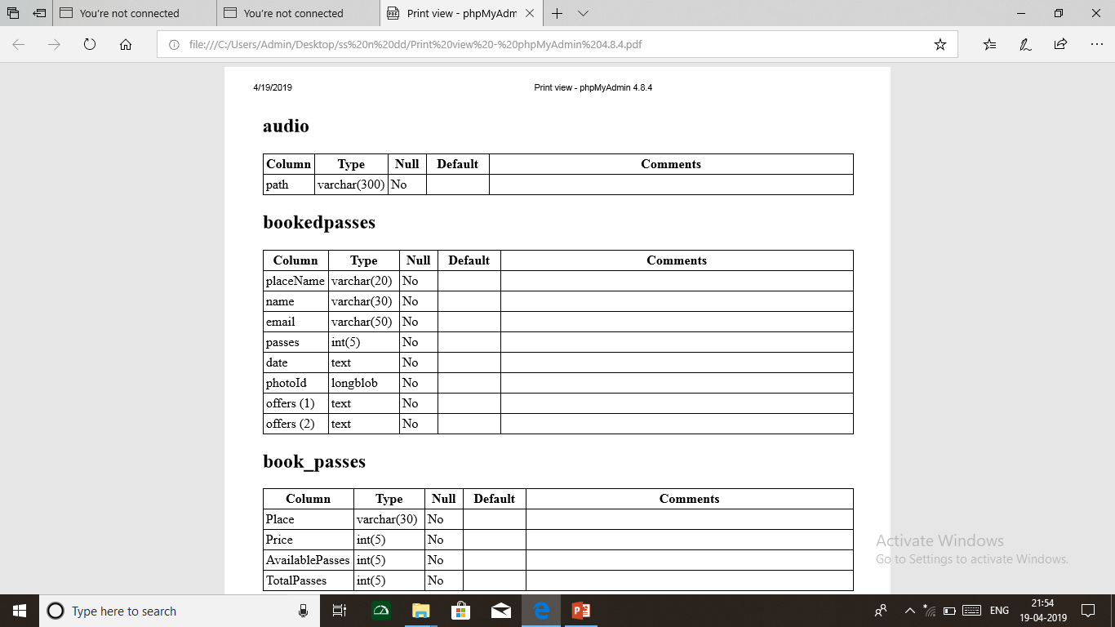
DATA DICTIONARY
RECORD OF AUDIO SONGS AND BOOKED PASSES AND BOOK PASSES

Slide 8

DATA DICTIONARY
RECORD OF GARBA PLACES AND OUTFIT STORES

Slide 9
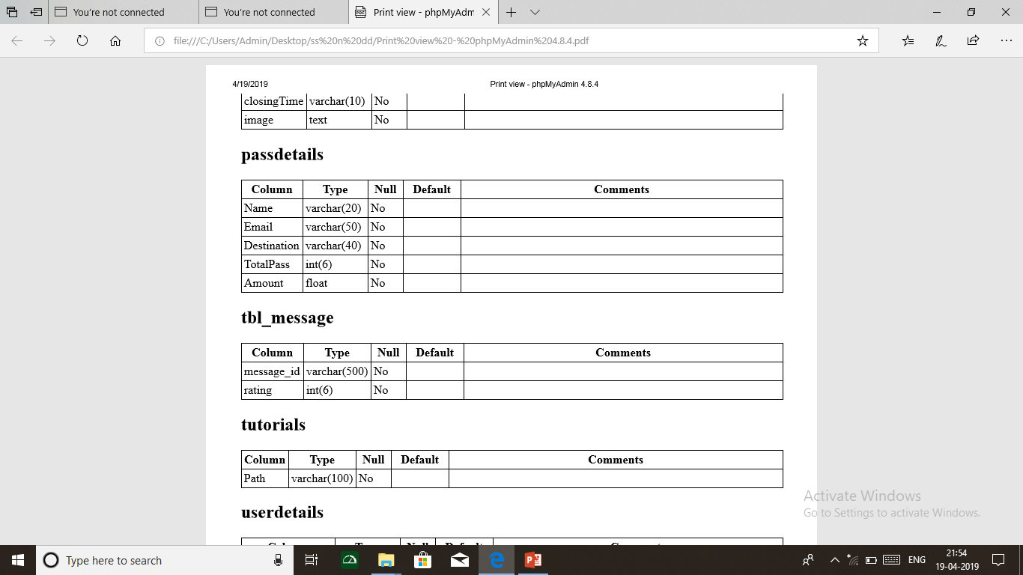
DATA DICTIONARY
RECORD OF PASS DETAILS, FEEDBACK DETAILS AND GARBA TUTORIALS

Slide 10
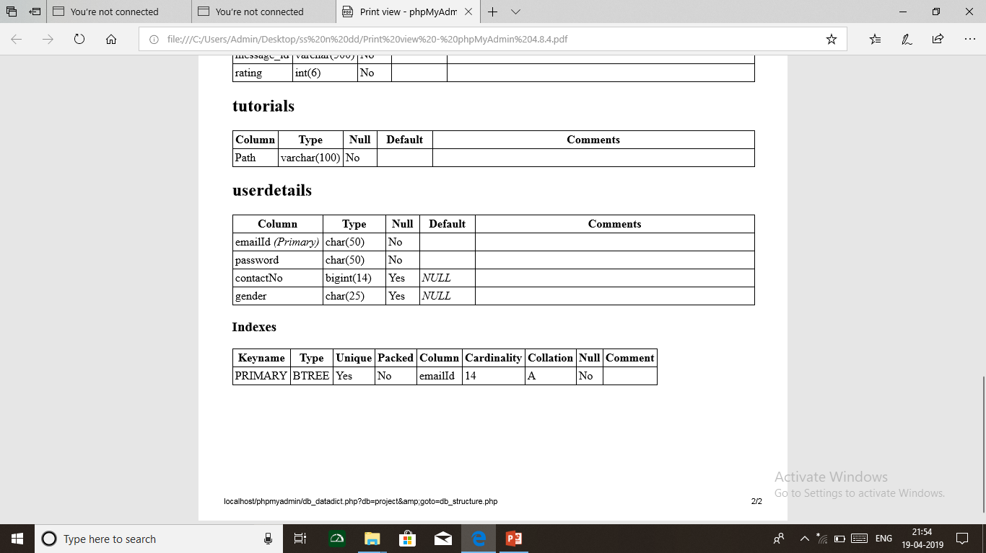
DATA DICTIONARY
RECORD OF USER DETAILS

Slide 11
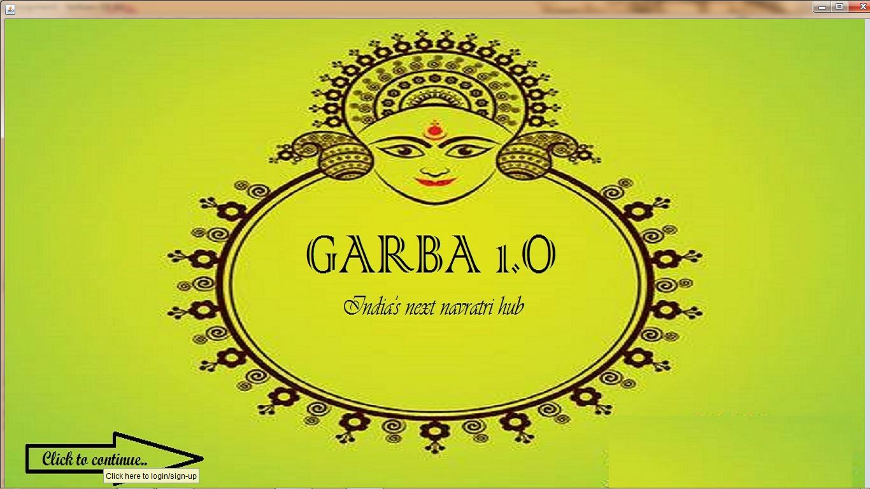
FIRST PAGE

Slide 12
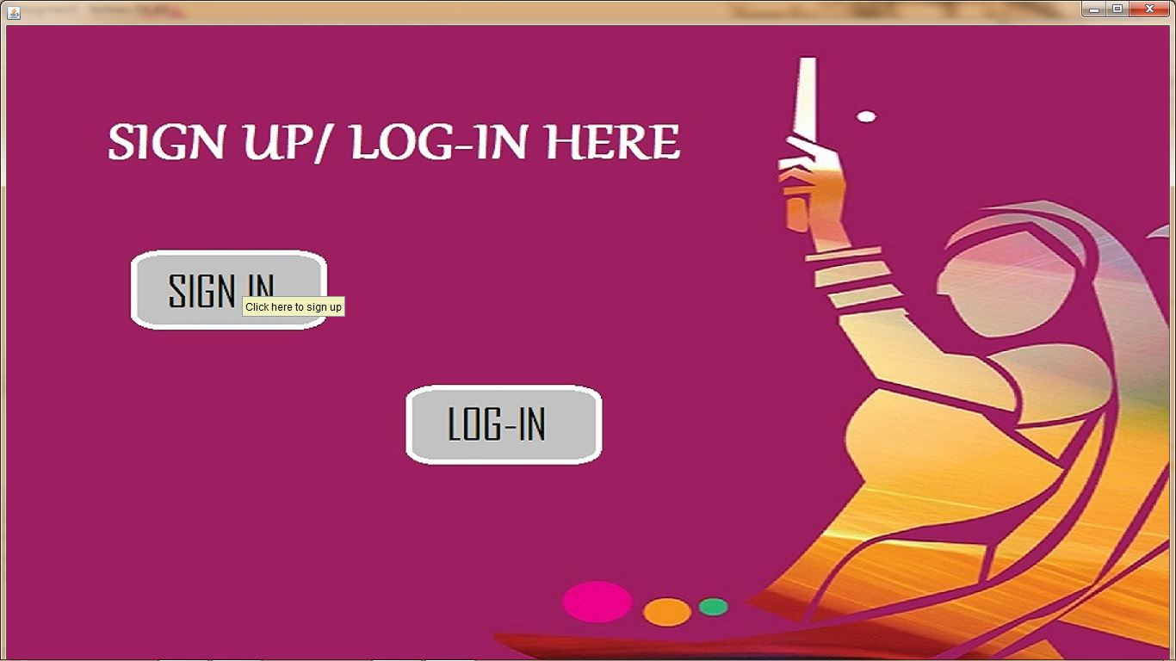
LOGIN/SIGN-UP PAGE

Slide 13
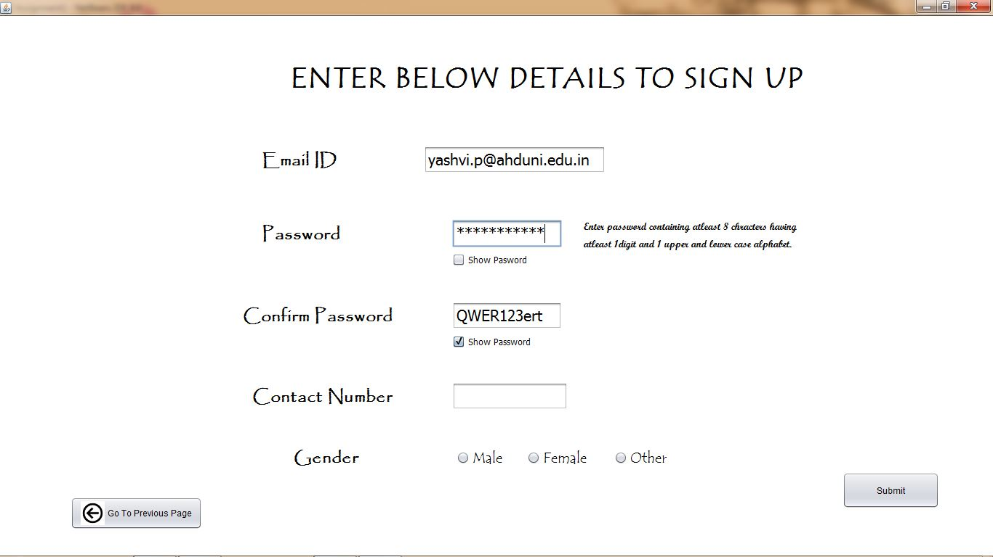
AFTER CLICKING ON SIGN-UP IN THE PREVIOUS PAGE

Slide 14
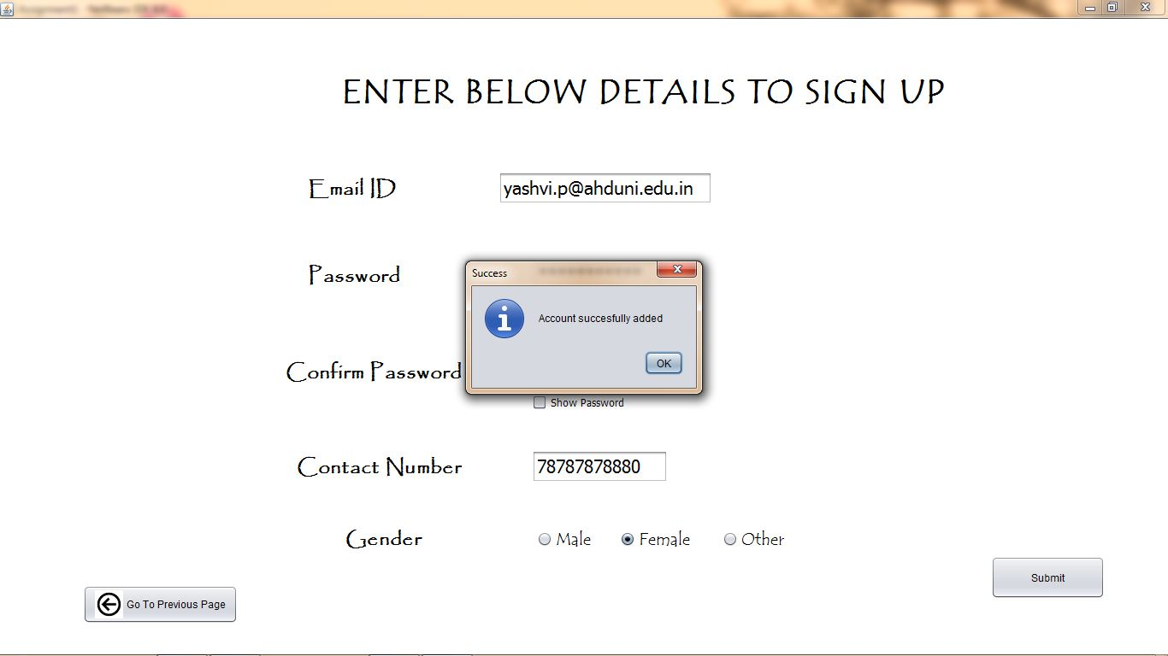
WHEN SIGN-UP IS SUCCESSFUL

Slide 15

TO LOGIN

Slide 16
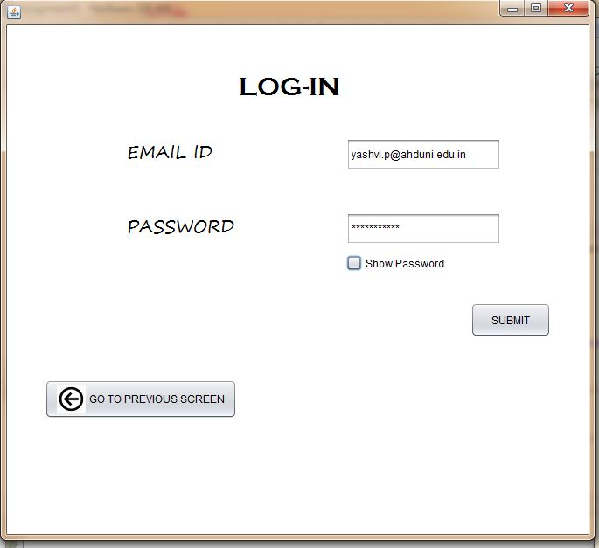
WHEN USER LOGINS

Slide 17
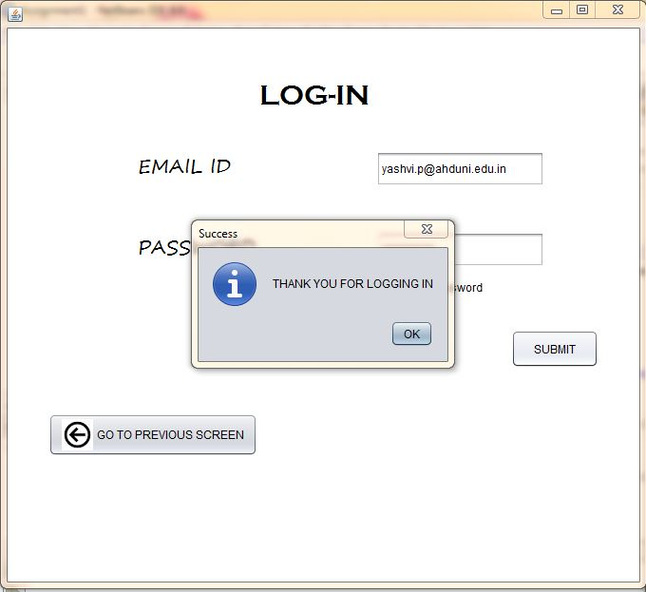
WHEN LOGIN IS SUCCESSFUL

Slide 18
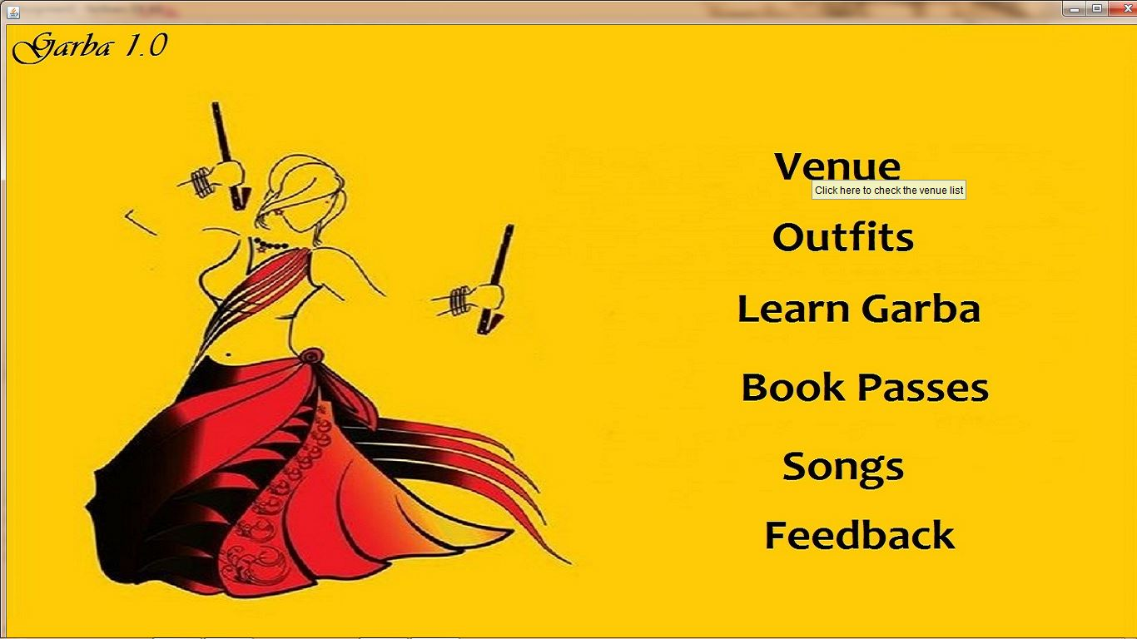
MAIN MENU

Slide 19
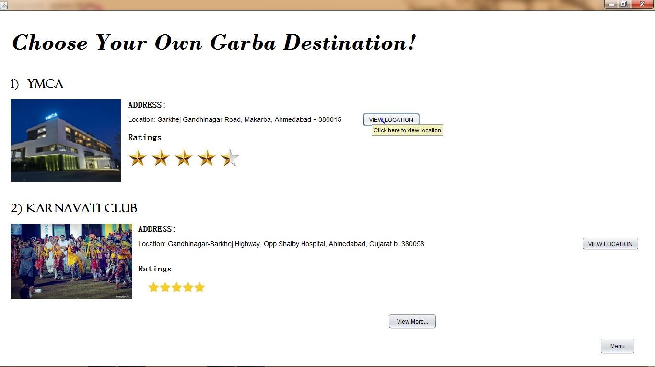
VENUE PAGE-1

Slide 20
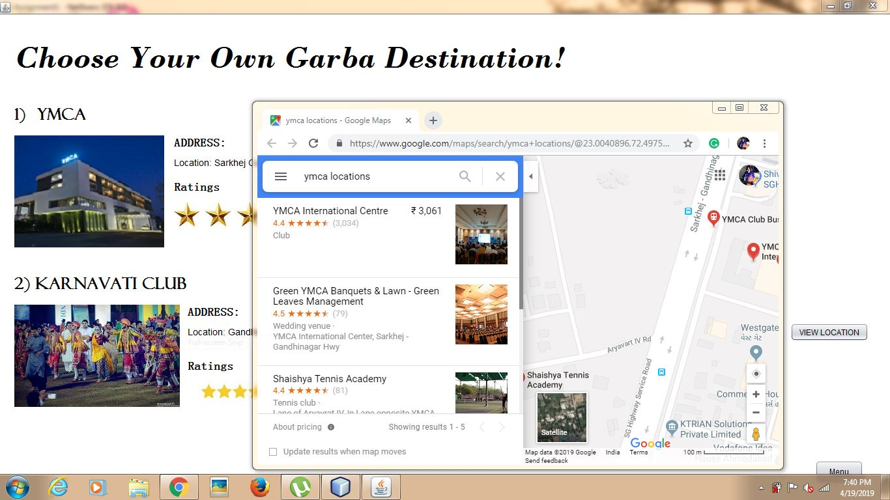
WHEN VIEW LOCATION IS CLICKED

Slide 21
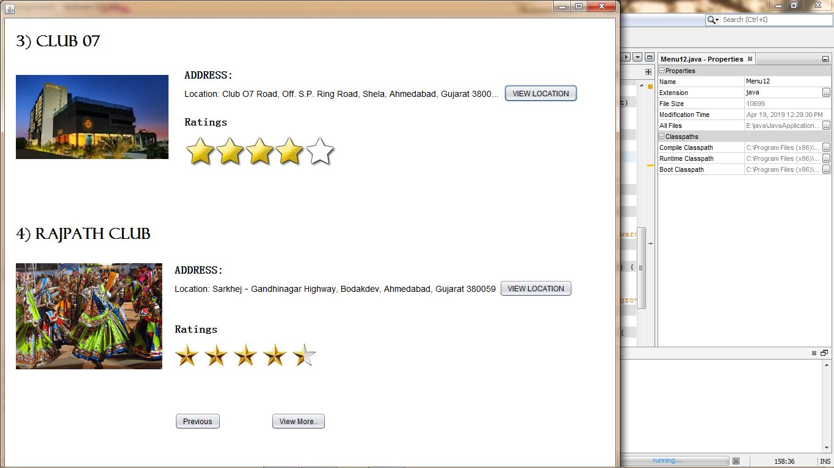
VENUE PAGE-2

Slide 22
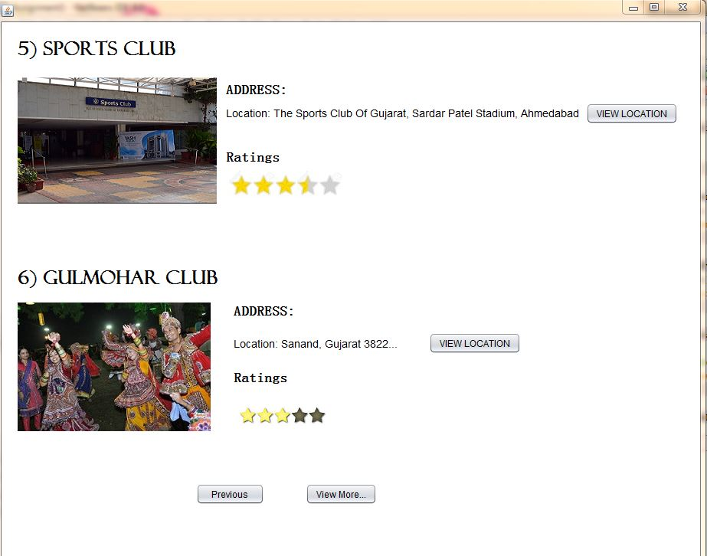
VENUE PAGE-3

Slide 23
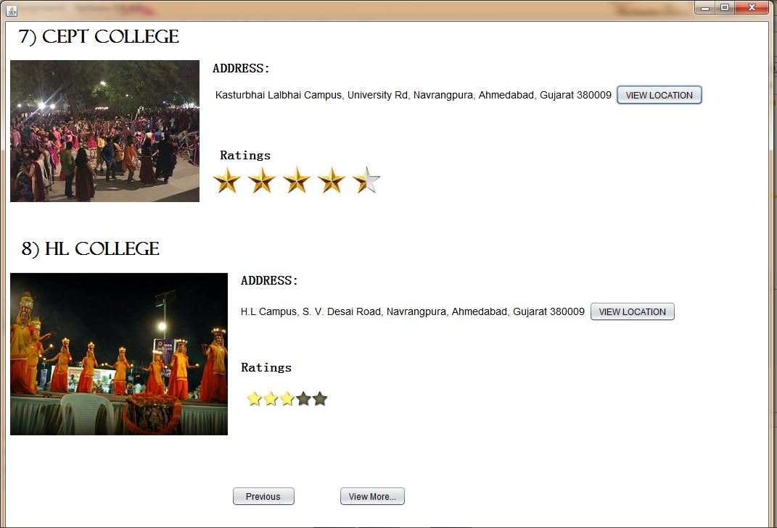
VENUE PAGE-4

Slide 24
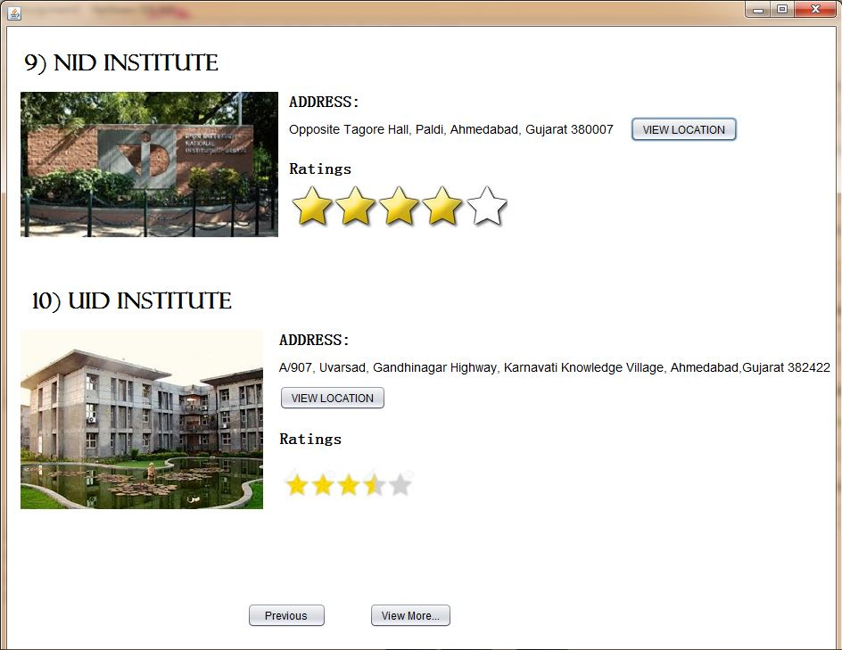
VENUE PAGE-5

Slide 25
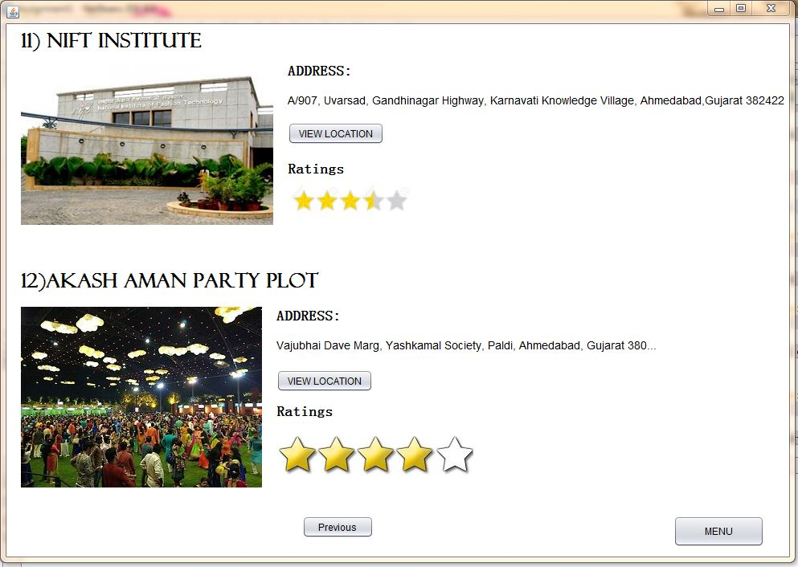
VENUE PAGE-6

Slide 26
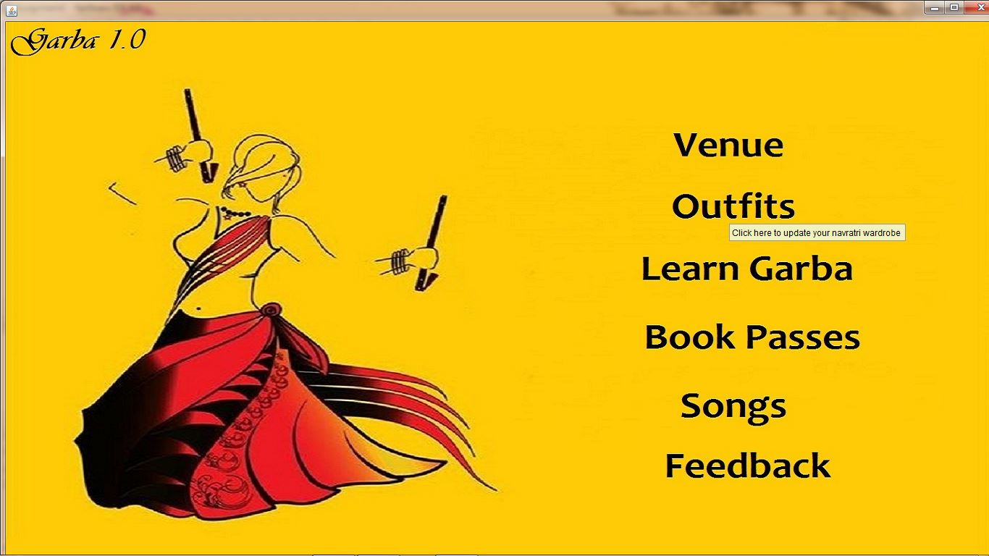
WHEN OUTFIT IS CLICKED ON THE MAIN MENU

Slide 27
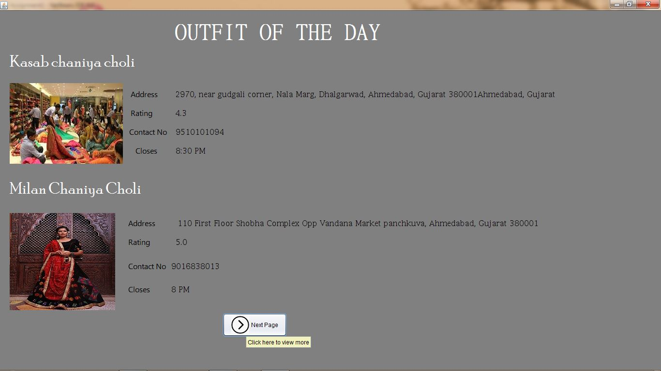
OUTFIT PAGE-1

Slide 28
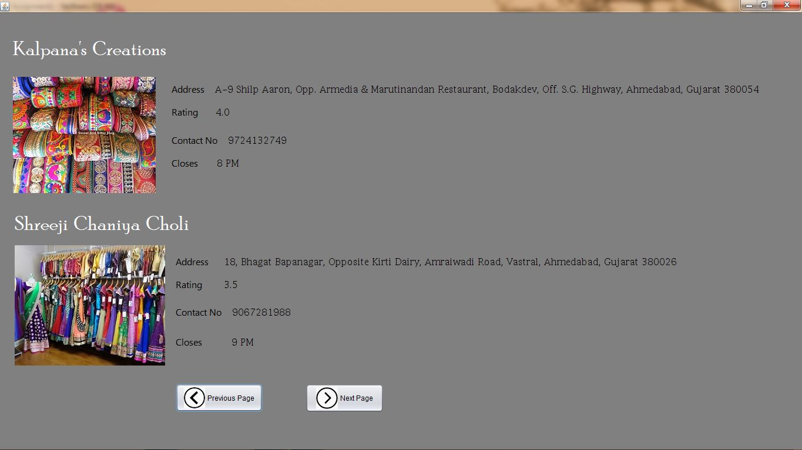
OUTFIT PAGE-2

Slide 29
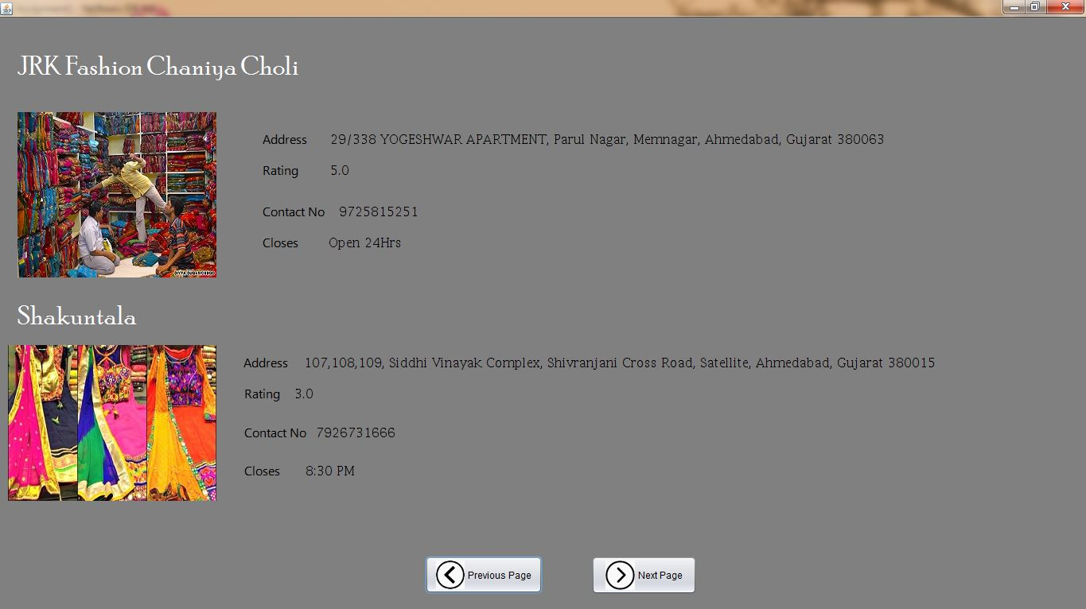
OUTFIT PAGE-3

Slide 30
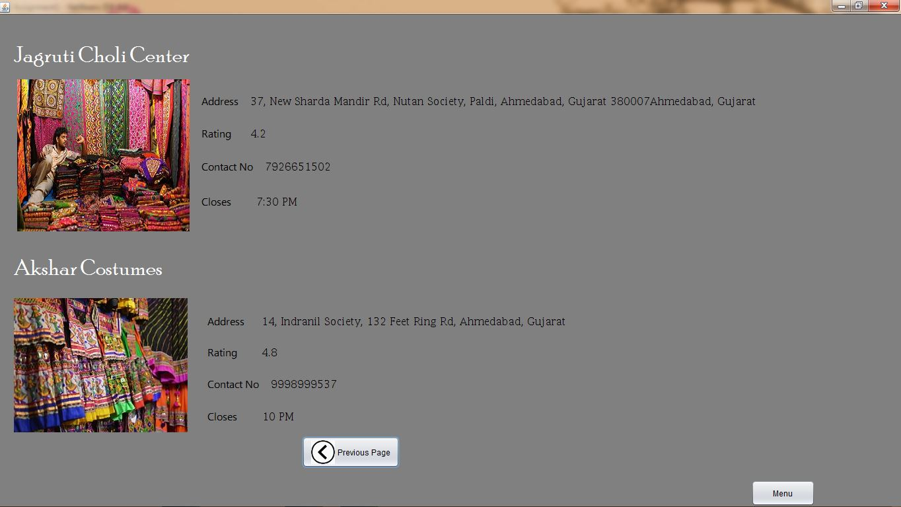
OUTFIT PAGE-4

Slide 31

WHEN LEARN GARBA FROM THE MAIN MENU IS CLICKED

Slide 32
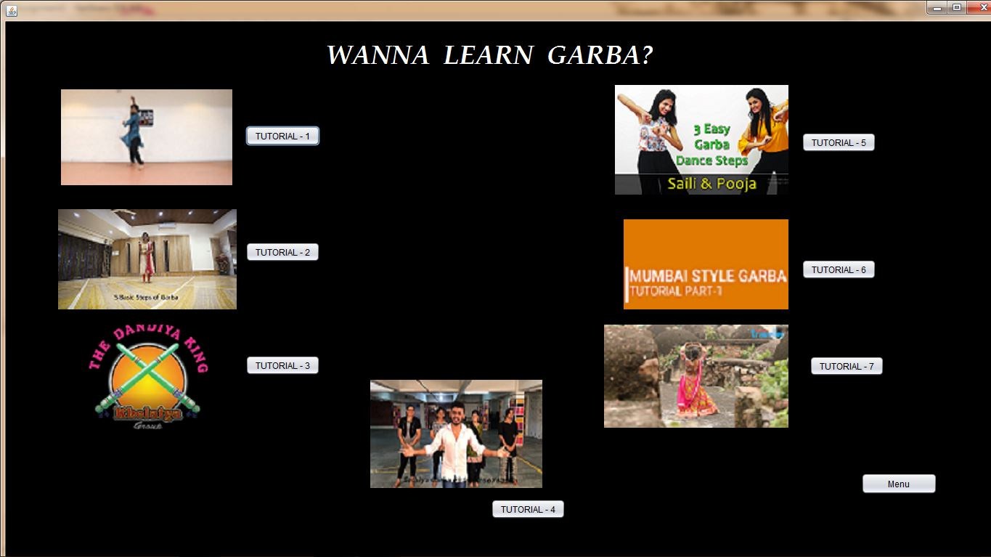
VIDEOS LIST

Slide 33
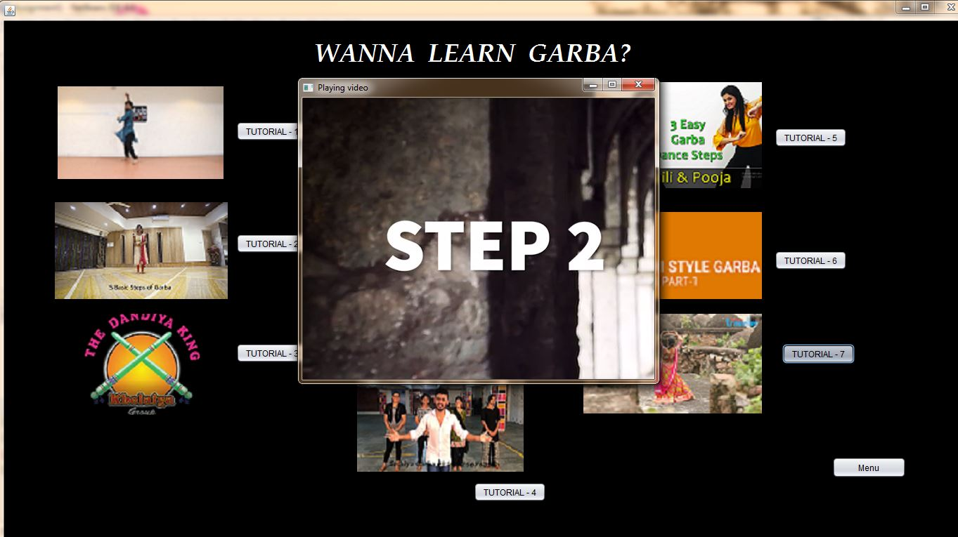
WHEN ANY ONE TUTORIAL IS CLICKED

Slide 34
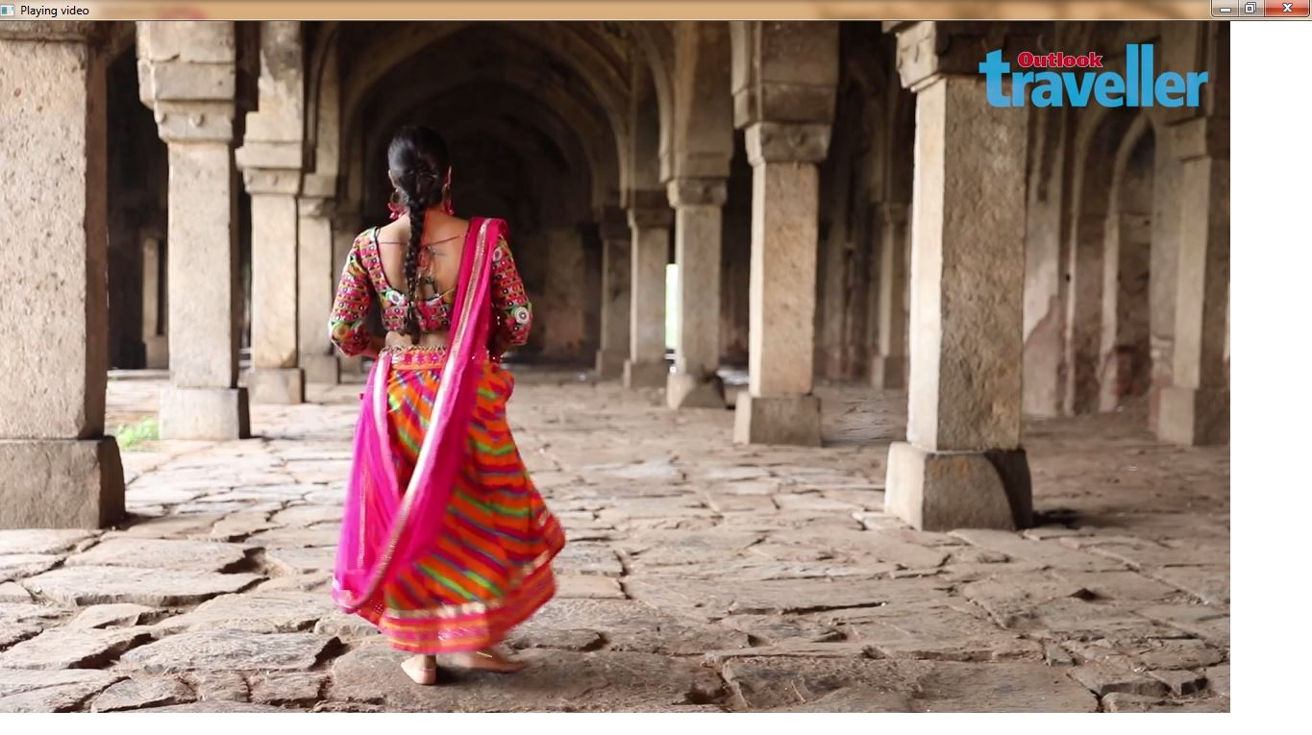
VIDEO PLAYING

Slide 35
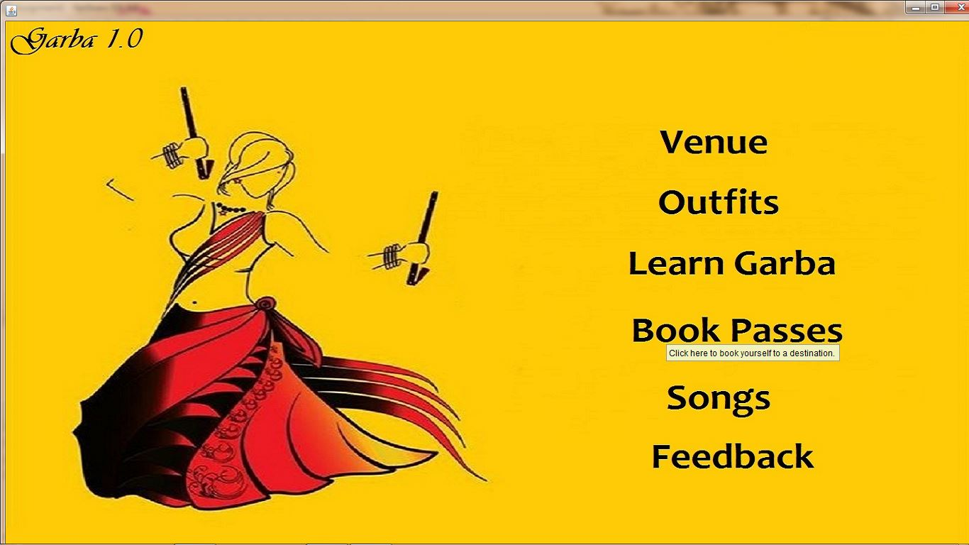
WHEN BOOK PASSES IS CLICKED

Slide 36
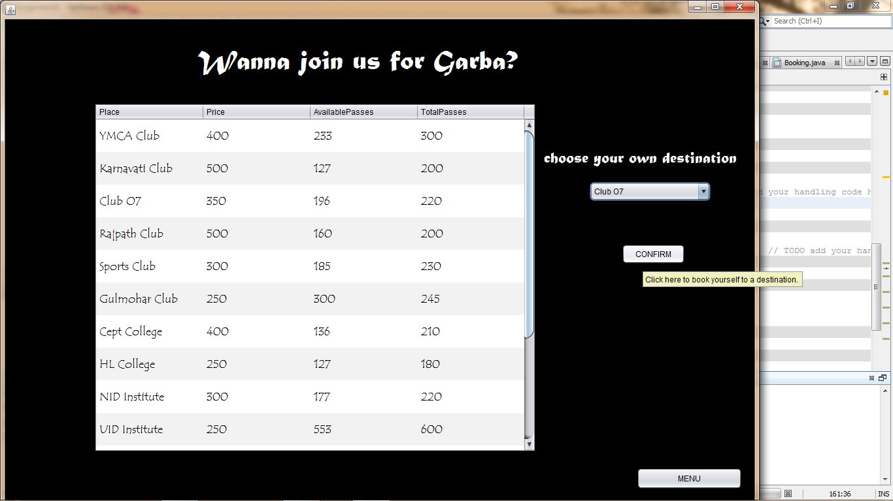
LIST OF PASSES AND VENUES-1

Slide 37
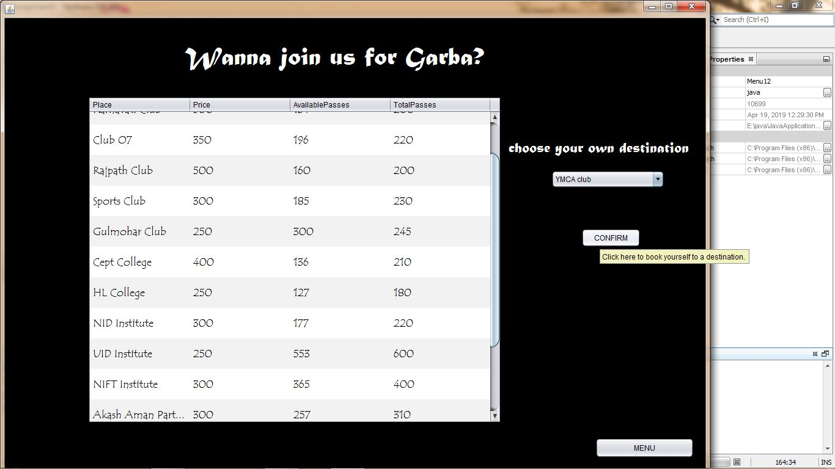
LIST OF PASSES AND VENUES-2

Slide 38
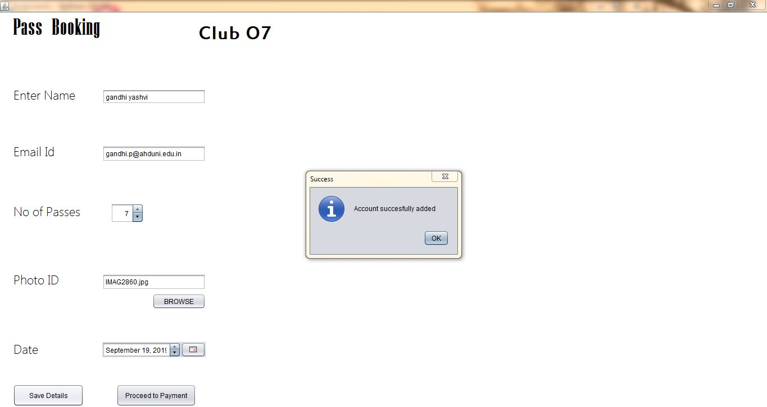
WHEN ANY 1 VENUE IS SELECTED(e.g. CLUB 07) AND BOOKED SUCCESSFULLY

Slide 39
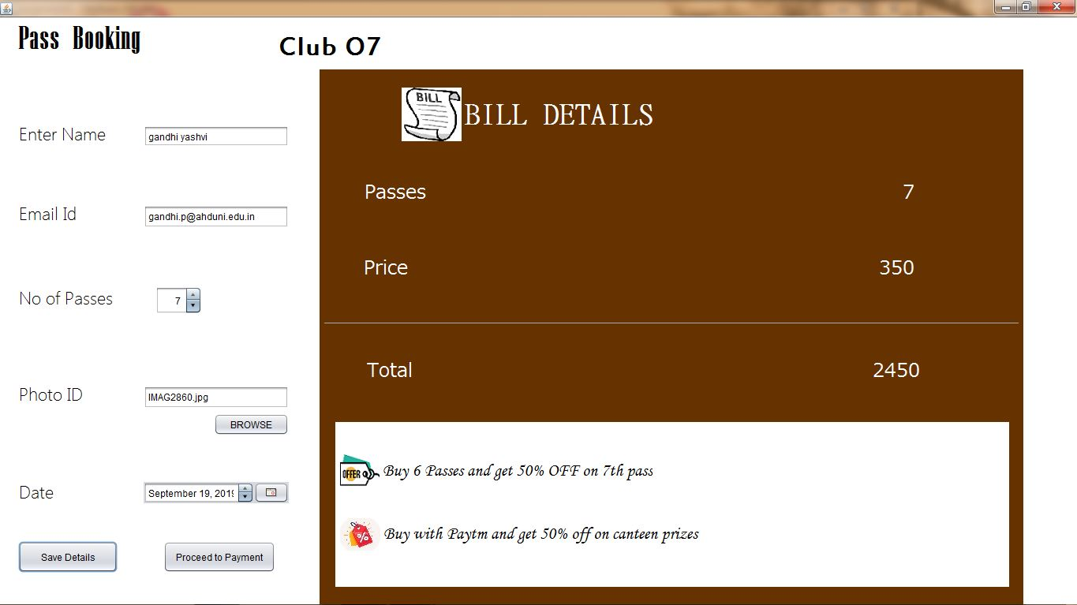
BILL DETAILS WITH OFFERED DISCOUNTS

Slide 40
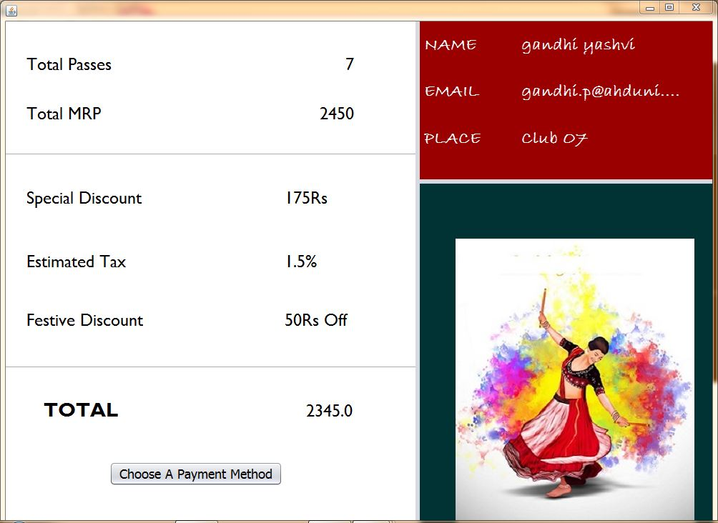
FINAL BILL

Slide 41
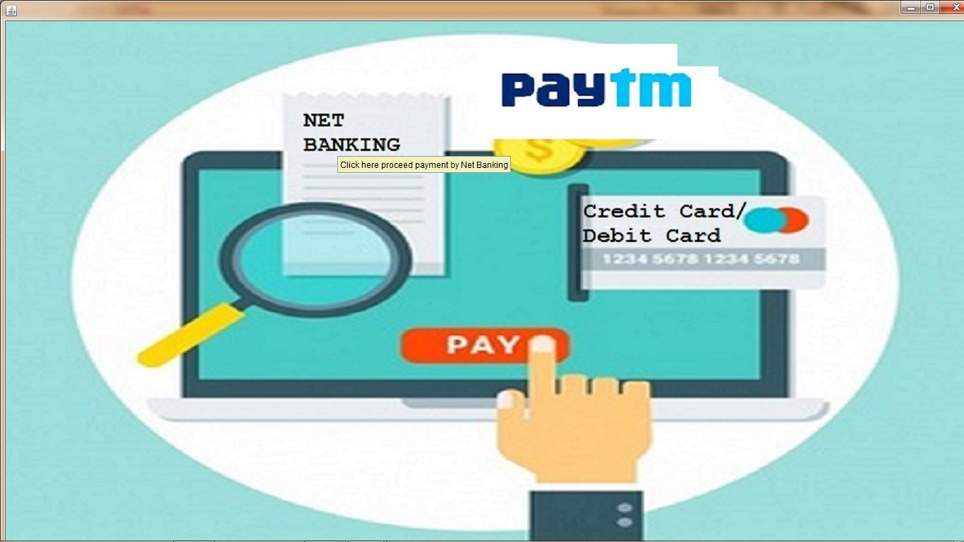
PAYMENT MODE PAGE

Slide 42
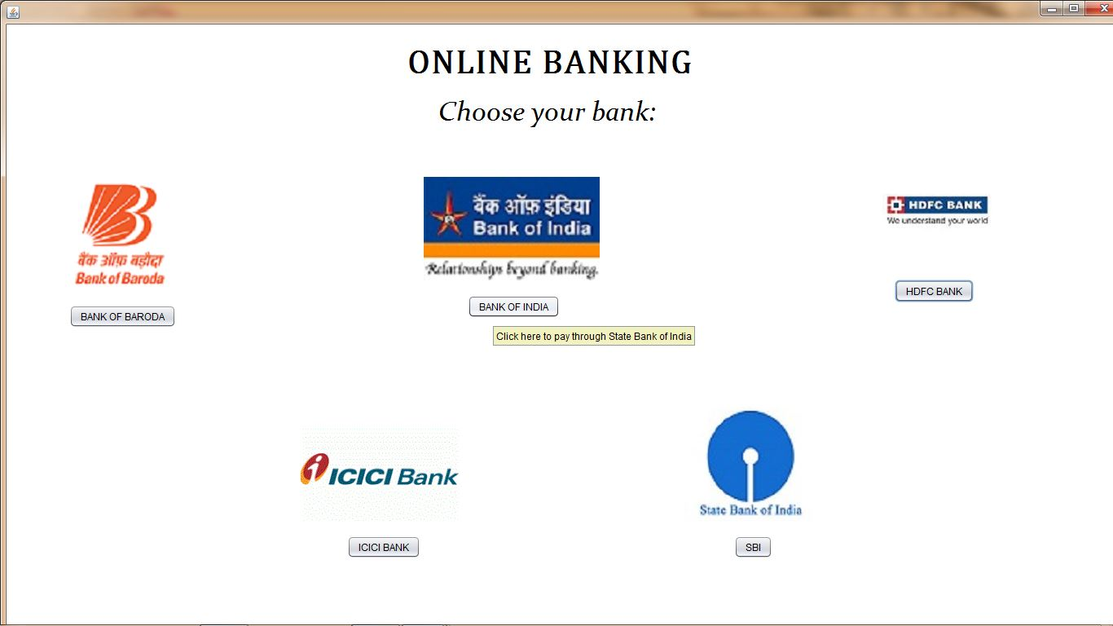
ONLINE BANKING PAGE(when online banking option is selected from the payment mode page.)

Slide 43
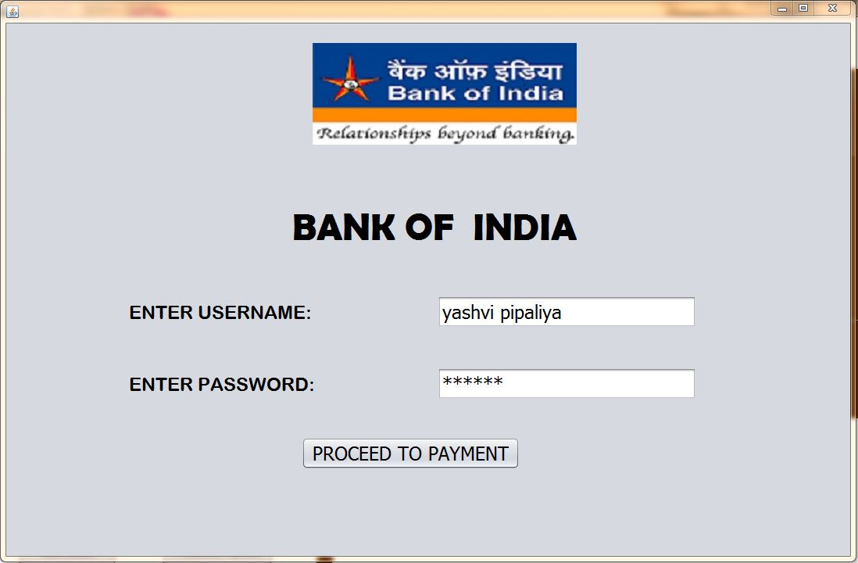
BANK PAGE(e.g. Bank of India is selected)

Slide 44
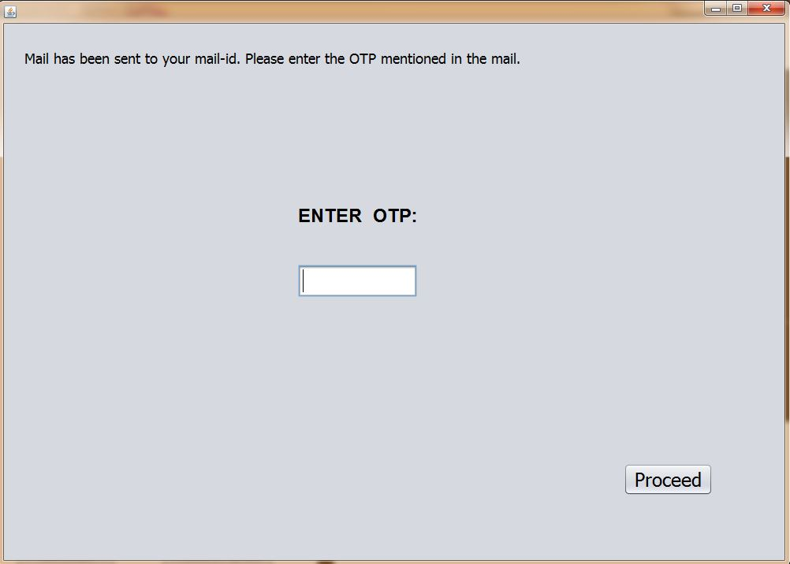
OTP PAGE(after clicking on proceed to payment in bank page)

Slide 45
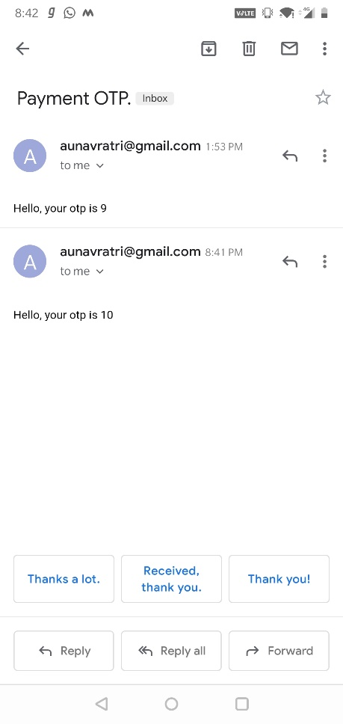
RECEIVED MAIL WITH OTP

Slide 46
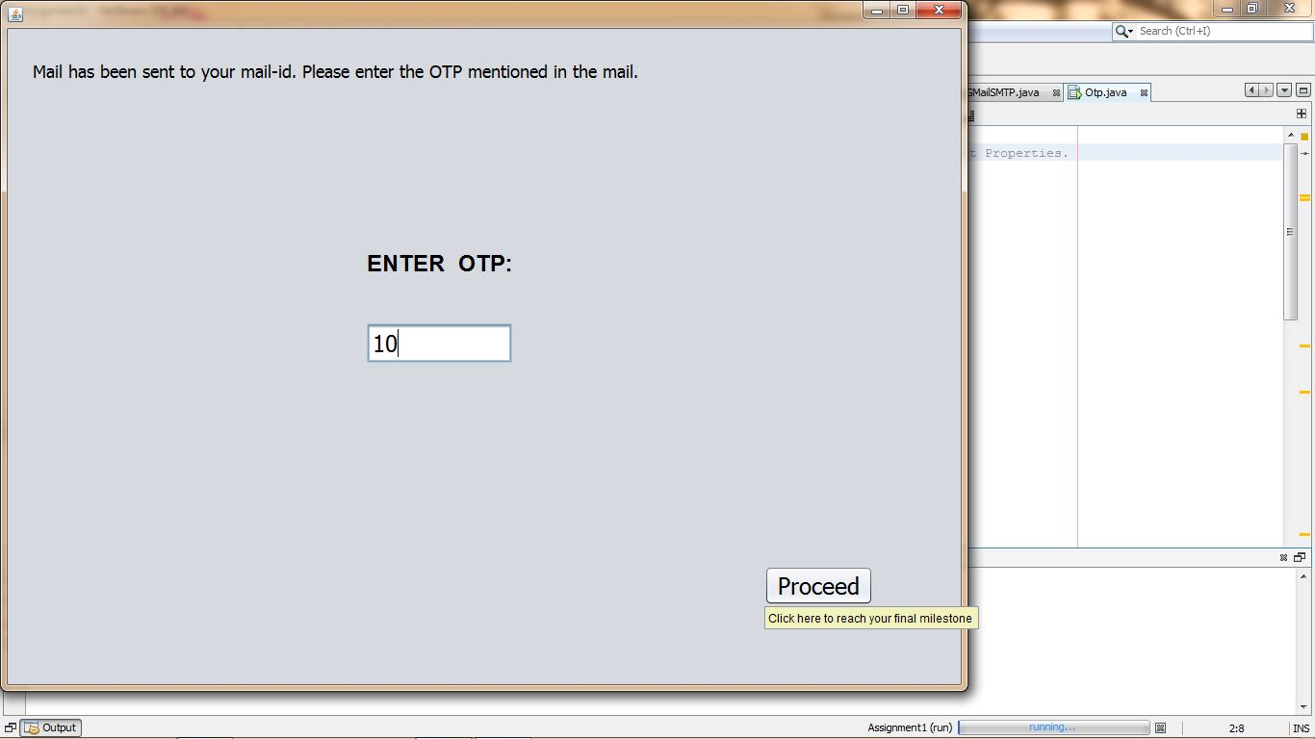
CLICKING ON PROCEED AFTER ENTERING CORRECT OTP

Slide 47
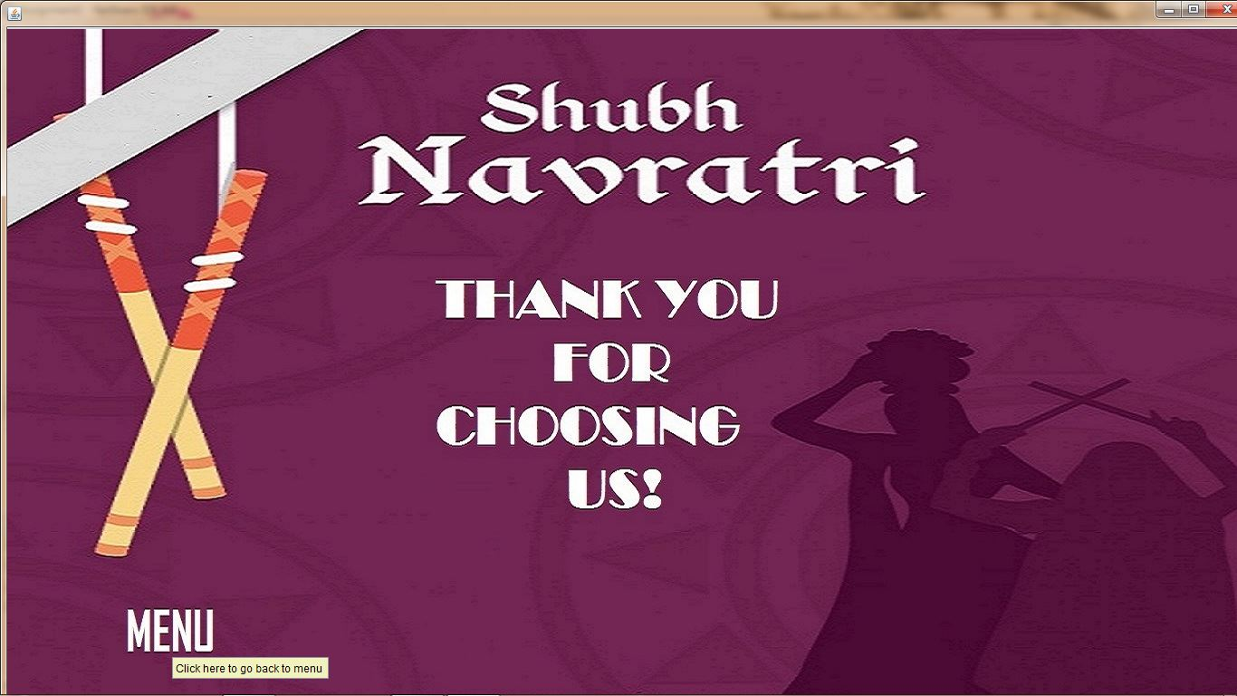
ON SUCCESSFUL BOOKING

Slide 48
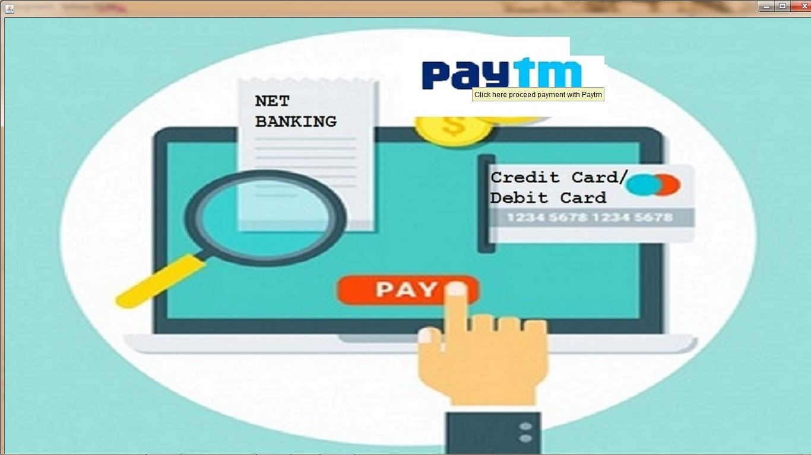
SELECTING PAYTM MODE

Slide 49
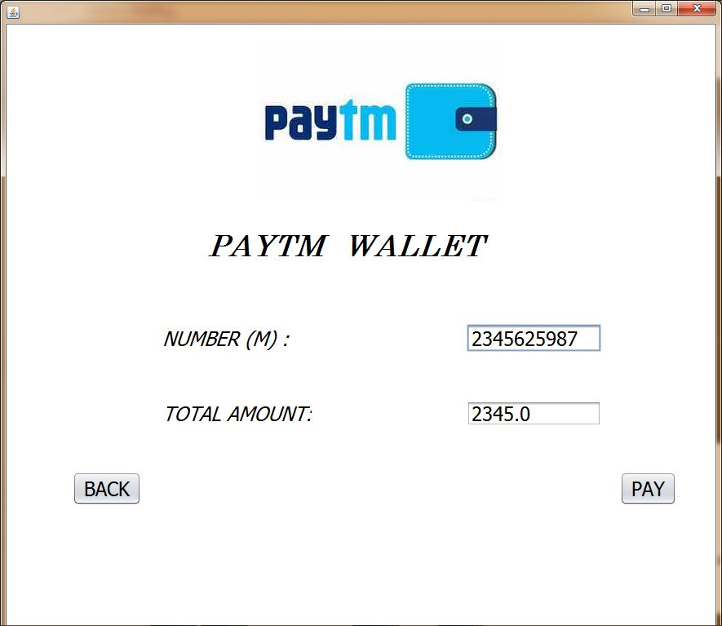
TO PAY THROUGH PAYTM

Slide 50
ON SUCCESSFUL PAYMENT

Slide 51
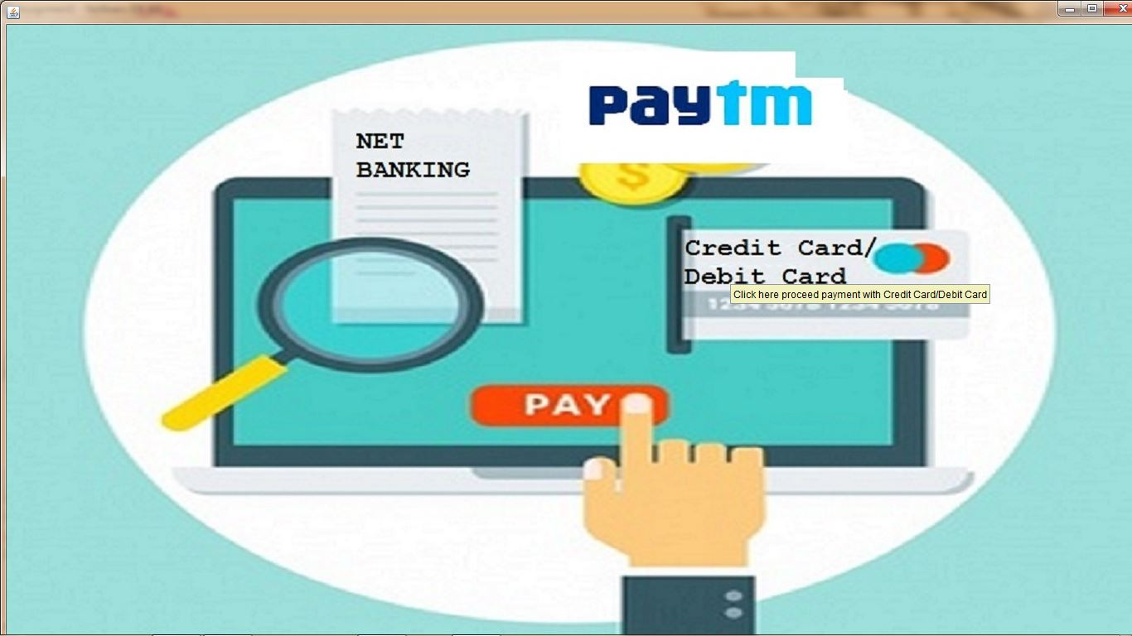
TO PAY THROUGH CREDIT/DEBIT CARD

Slide 52
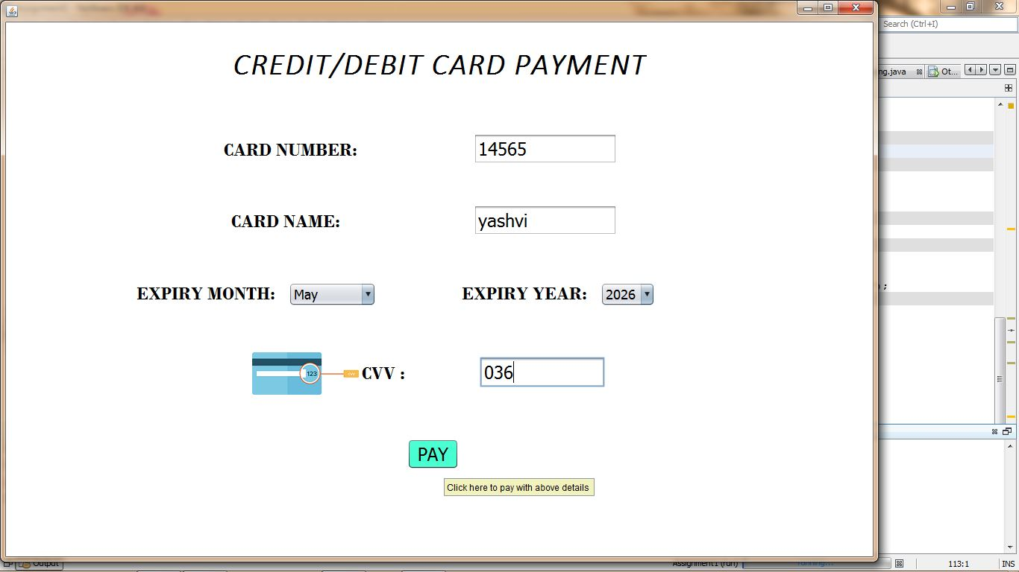
ADDING CREDIT/DEBIT CARD DETAILS

Slide 53
ON SUCCESSFUL BOOKING

Slide 54
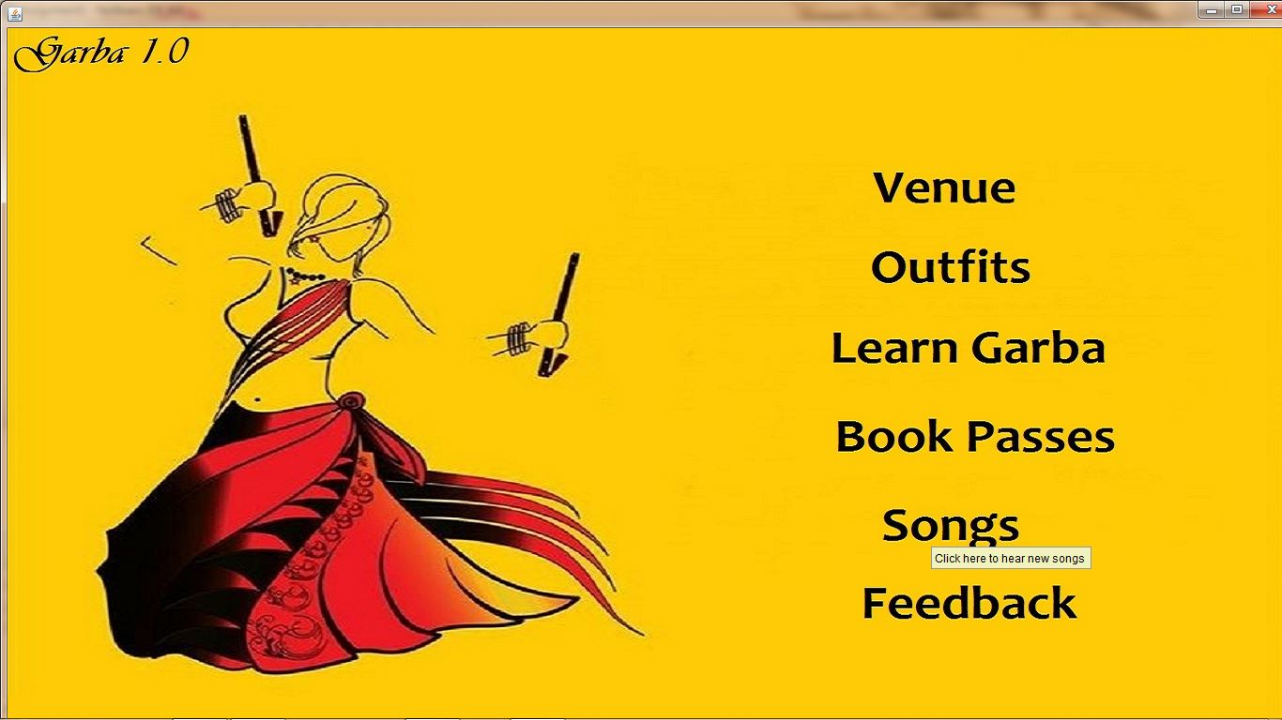
WHEN SONGS IS SELECTED FROM THE MAIN MENU

Slide 55
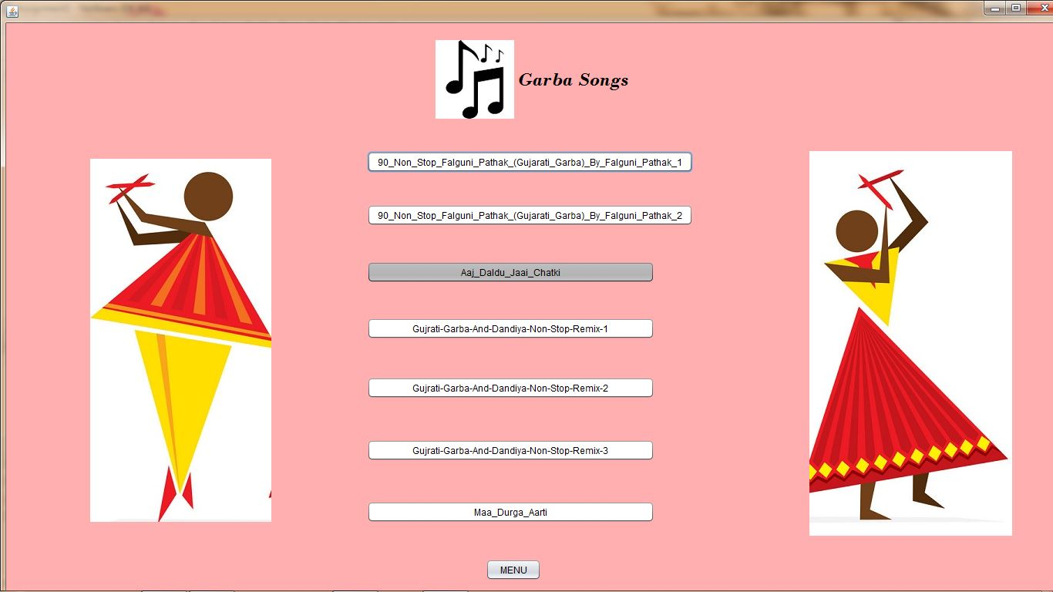
SONGS LIST

Slide 56
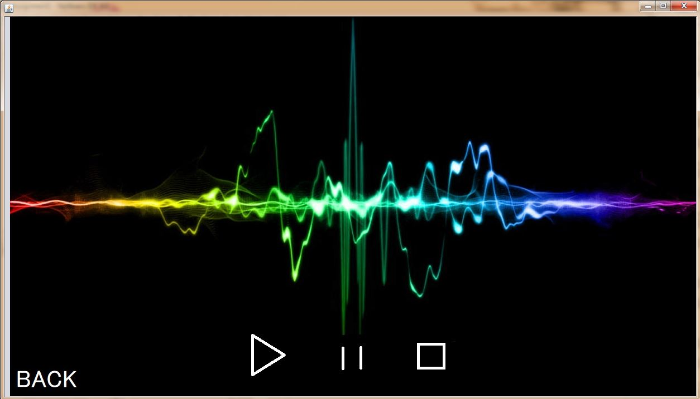
WHEN ANY 1 SONG IS SELECTED (song is being played)

Slide 57

WHEN FEEDBACK IS SELECTED

Slide 58
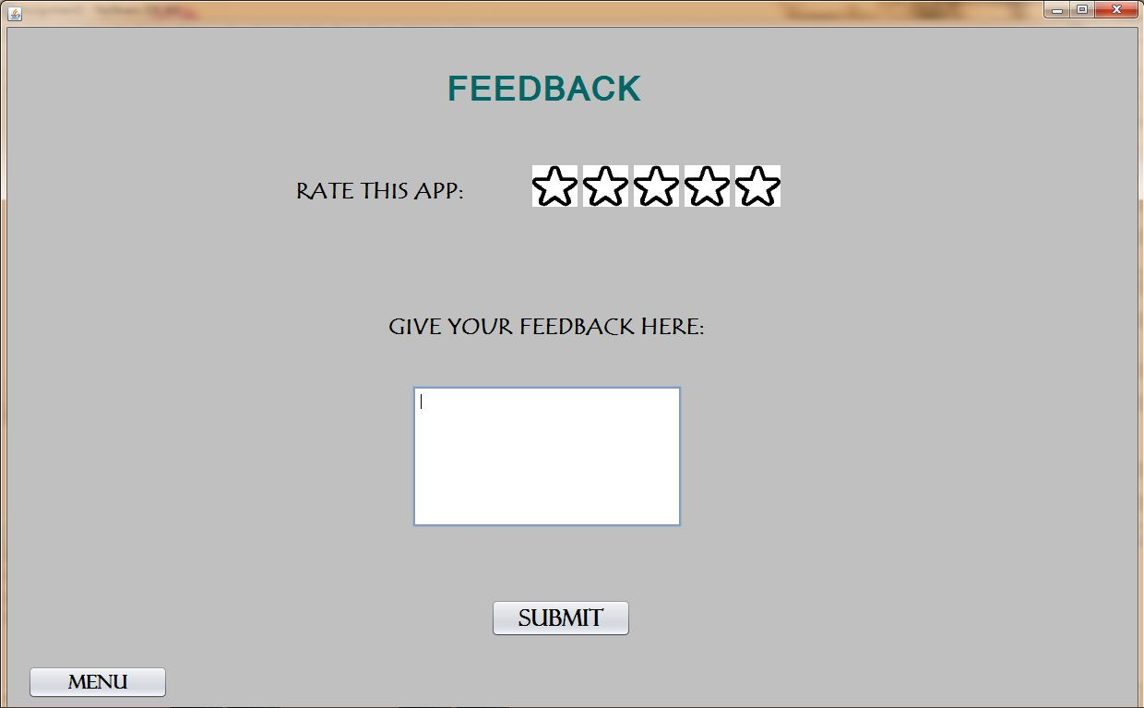
FEEDBACK PAGE

Slide 59
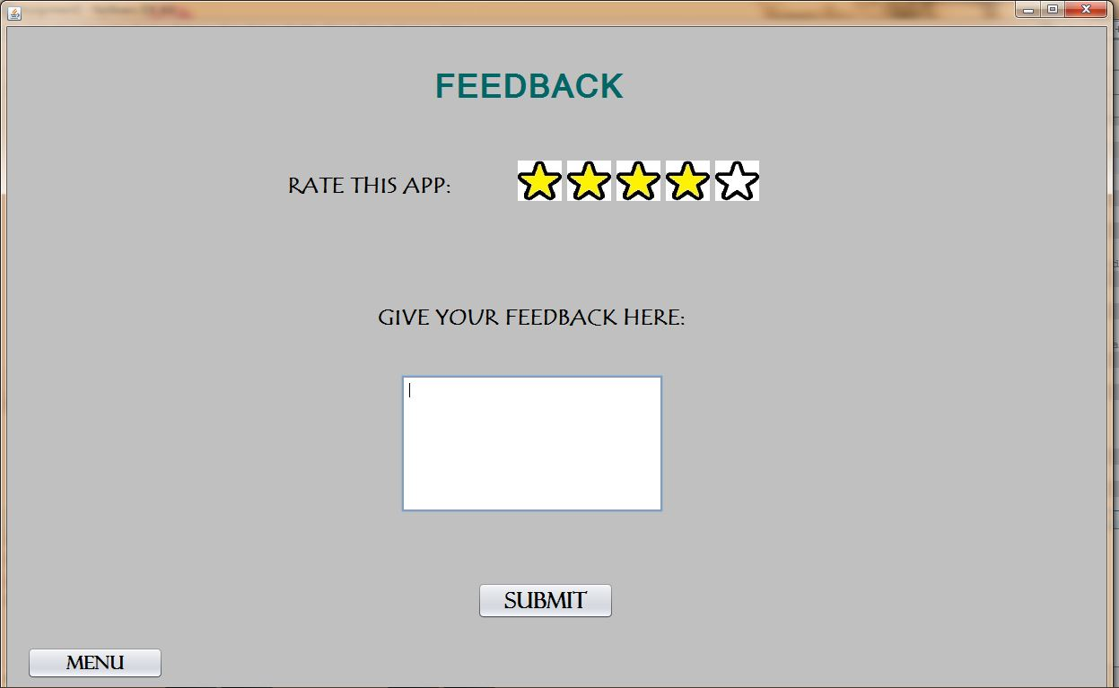
WHEN USER ENTERED THE RATINGS

Slide 60
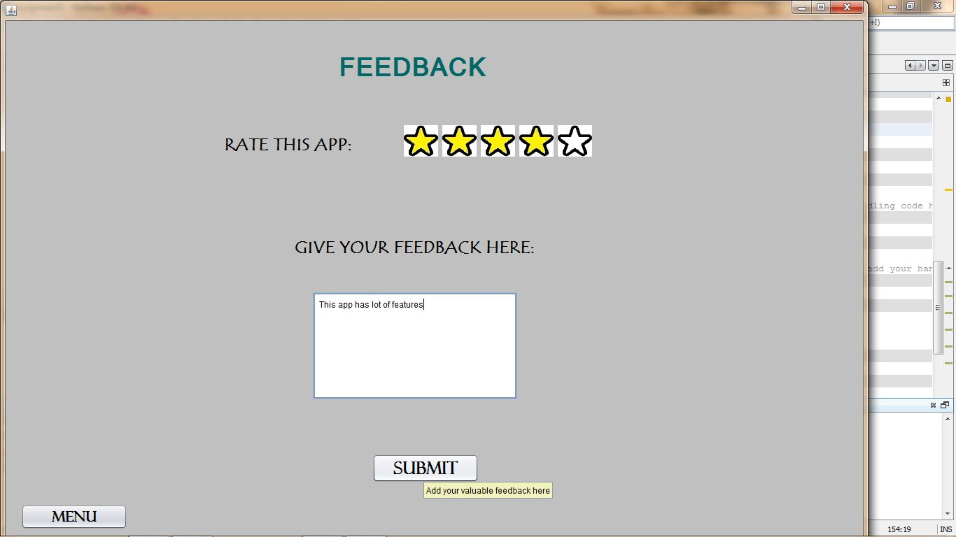
WHEN FEEDBACK IS ENTERED

